Slide 1
Antivirus Decommission and Deployment using Kaseya
Developed By: Celia McFadden
Advisor : Dr. S. Masoud Sadjadi
School of Computing and Information Sciences
Florida International University
Your cthom012@fiu.edu
http://www.cs.fiu.edu/~sadjadi/

Slide 2
Agenda
Problem and Motivation
Solution
Behind the Scene
Customizing the Solution
Disclaimer
Progress Report

Slide 3
Problem and Motivation:
The University of Miami recently ended its software licensing contract with McAfee AntiVirus. It is necessary to remove all instances of previously installed McAfee programs as to not violate the software licenses.
The University’s new antivirus contract is with Symantec EndPoint Protection. As all machines must be protected to maintain University resources, Symantec must be installed across the campus.

Slide 4
Fig 1.1

Slide 5
Solution
Utilizing Kaseya, an agent procedure will be used to run the McAfee uninstall command an all University machines.
An agent procedure will also be used to install Symantec EndPoint Protection on all University machines

Slide 6
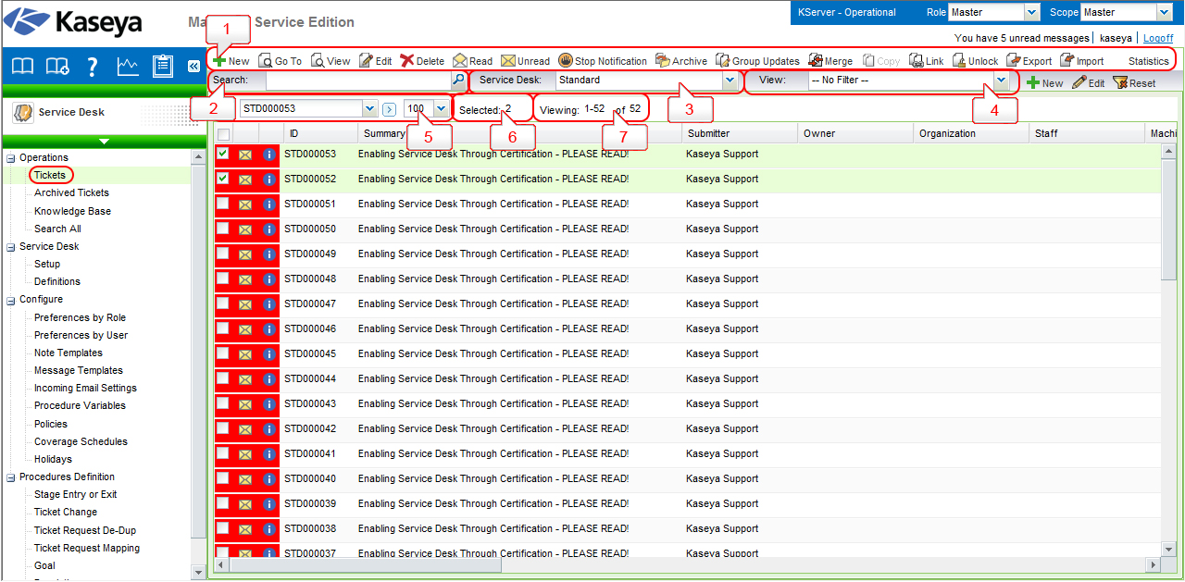
Fig 2.1

Slide 7
Behind the Scene
McAfee – Standard removal Agent procedure
  Customized Agent procedure to run specific uninstall file for the McAfee version licensed to the University.
    The procedure will scan the machine for the McAfee uninstall file and run it.
Symantec – Install
  Use Application deploy (agent procedure to deploy application installation file) ; run the install file.

Slide 8
Fig 3.1

Slide 9
Customizing the Solution
A separate agent procedure and uninstall/install file will be necessary for Macintosh users.
The agent procedure will need to be updated with new uninstall/install file of software if one becomes available due to upgrades/ updates

Slide 10
Fig 4.1

Slide 11
Disclaimer
The agent procedures are limited to the current install/uninstall files available.
The procedures depend on the fact that these machines are already managed and do not allow users to download any other anti-virus files

Slide 12
Progress Report
How far have you gone with your solution?
  Stated specific problem and motivation
  Tested and confirmed “Uninstall” Agent procedure
Currently in progress:
  Testing “Install” Application deploy agent procedure
What is still not done?
  Write-up and video
etc.

